Slide 1
WORKOOPOLIS
Version Control with Git

Slide 2
Version Control with Git
What is version control
What is Git
Why Git for your organization
Install Git
Common commands in Git
Working with Remote Repositories

Slide 3
What is version control
Version control systems are a category of software tools that help a software team manage changes to source code over time.
Version control is also known as Source Code Management tool.
Version control software keeps track of every modification to the code in a special kind of database. If a mistake is made, developers can turn back the clock and compare earlier versions of the code to help fix the mistake while minimizing disruption to all team members.
Version control helps teams solve these kinds of problems, tracking every individual change by each contributor and helping prevent concurrent work from conflicting.
A system that keep records of your changers.
Allow for collaborative development.
Backup and restore.
Sync up with multiple computer/team

Slide 4
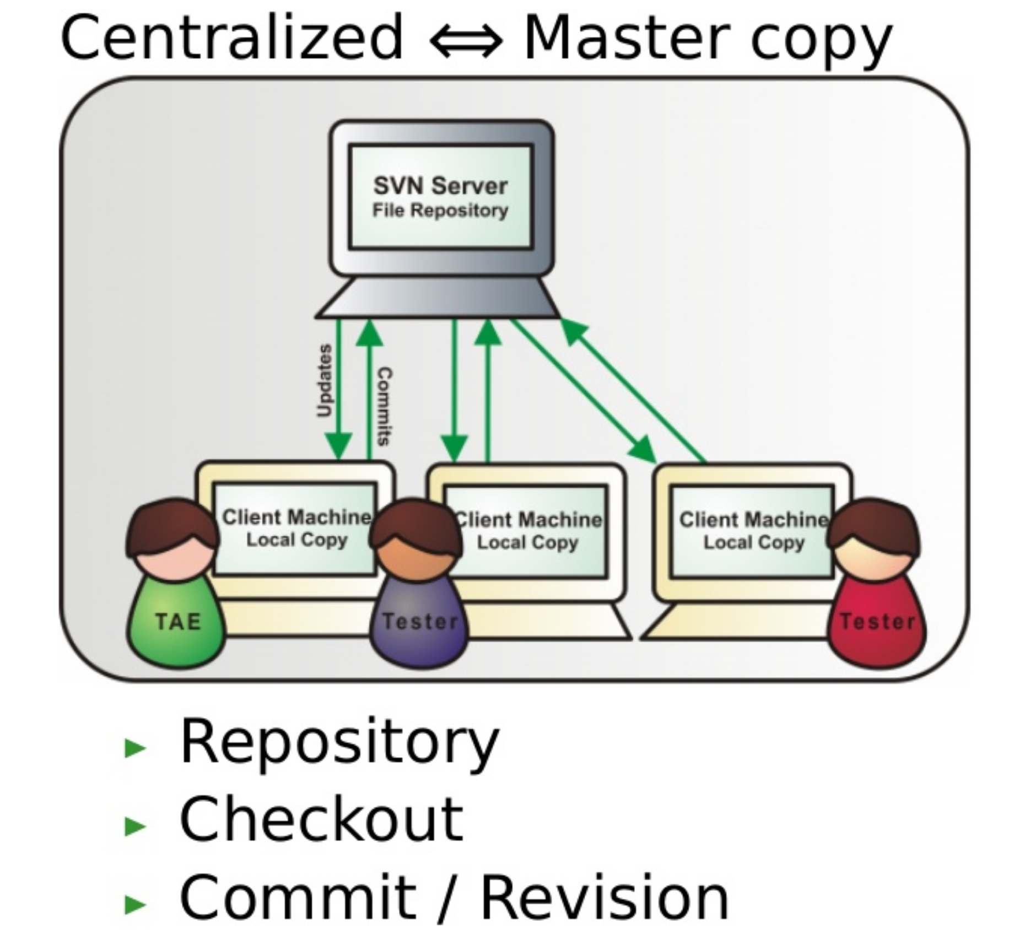
Types of version control
Centralized Version Control System
Tortoise SVN

Slide 5
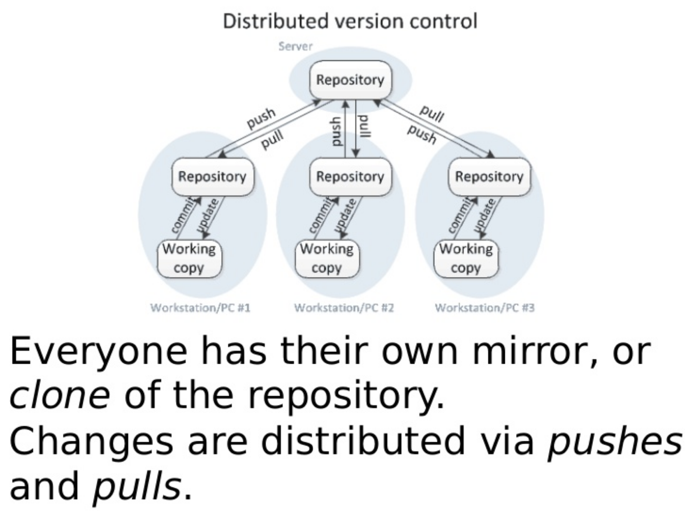
Types of version control
Distributed Version Control System
Git
Mercurial

Slide 6
What is Git
open source project
Largest web based git repository hosting service.
Distributed version control.
Developed in 2005 by Linus Torvalds, the famous creator of the Linux operating system kernel.
it works well on a wide range of operating systems and IDEs.
User keep entire code and history on their local machine.

Slide 7
Why Git for your organization
There are two type of github account.
Public Github
Private Github

Slide 8
Install Git
Open an account in github.
https://github.com
Installing the git client
Window
Linux
Window
https://git-scm.com/download

Slide 9
Configure SSH key for github account.
Open Terminal
Execute the following command
ssh-keygen -t rsa -b 4096 -C Sudhir.thakur@rediffmail.com
This creates a new ssh key, using the provided email as a label.
Generating public/private rsa key pair.
When you're prompted to "Enter a file in which to save the key," press Enter. This accepts the default file location.
Enter a file in which to save the key (/Users/you/.ssh/id_rsa): [Press enter]
At the prompt, type a secure passphrase. For more information
Enter passphrase (empty for no passphrase): [Type a passphrase]> Enter same passphrase again: [Type passphrase again]
https://help.github.com/en/articles/adding-a-new-ssh-key-to-your-github-account

Slide 10
Key Concept
Snapshots :
The way git keep track of your code history
Records what the file looks like at a given point of time.
User decided when to take the snapshot and for which file.
Commit :
Act of creating a snapshot.
It contains the information how the file changed from previously.
It’s a hash code.
Repository :
A collection of files and history of files.
Can live on local machine or remote server github.
The process of downloading the commit that does not exists in local machine from remote repository is called pulling changes.
The process of adding local changes to remote repository is called pushing changes.

Slide 11
Key Concept
Branches :
All commit in the git live in some branch.
There can be many branches but the main branch is called the master branch.

Slide 12
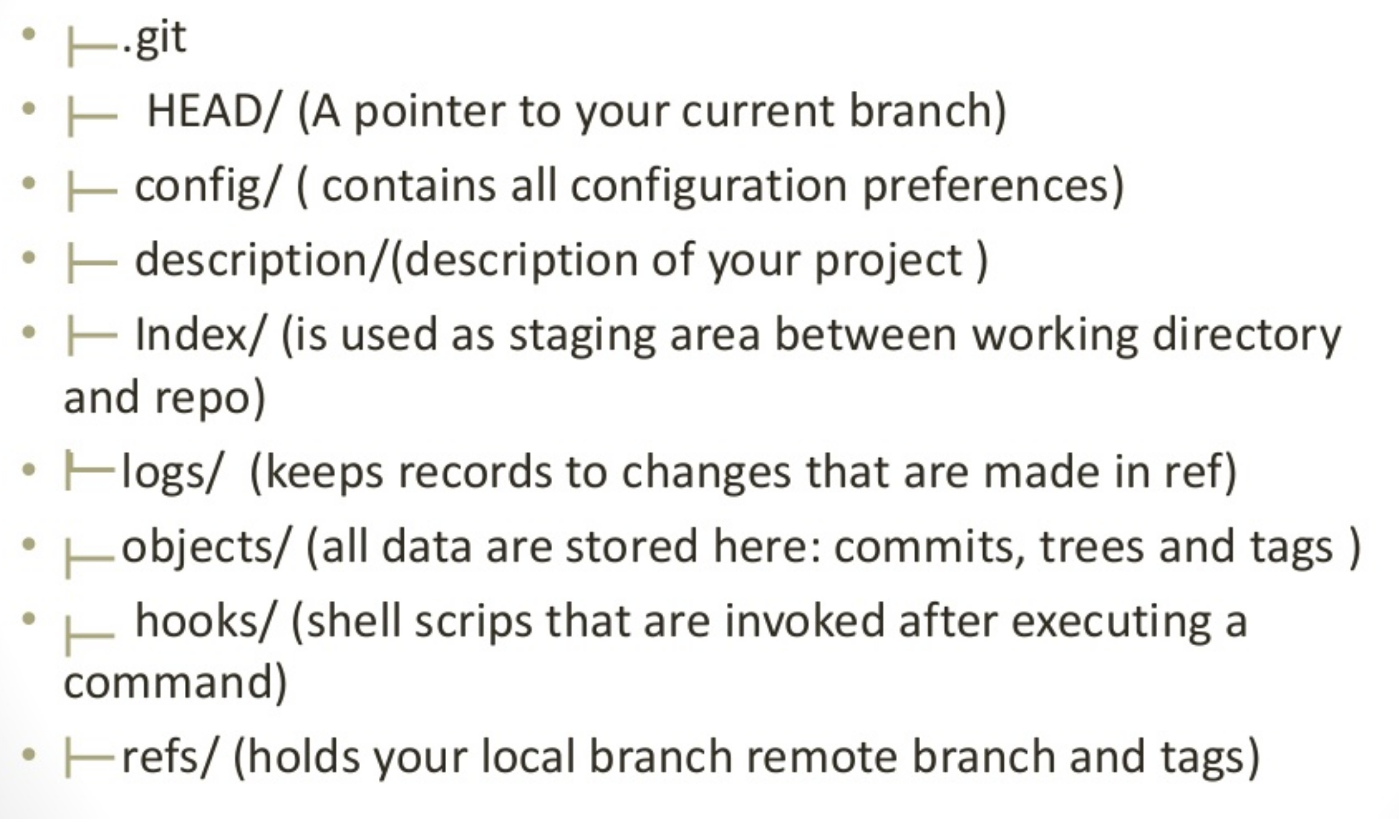
.git directory structure

Slide 13
Common commands in Git
git config –global user.name “[name]”
git config –global user.email “[email address]”
git init [repository name]
git clone [url]
git add [file]
git commit -m “[ Type in the commit message]”
git diff
git status

Slide 14
Common commands in Git
git rm [file]
git log
git show
git tag
git branch
git checkout
git push
git pull

Slide 15
Working with Remote Repositories
git clone https://github.com/sudhirkthakur/awscfs.git
git branch
git checkout –b test
git commit –m “update for testing”
git status
git branch
git push –u origin test

Slide 16
Hands on
GIT Installation
Version Control
Working with remote repository

